Slide 1
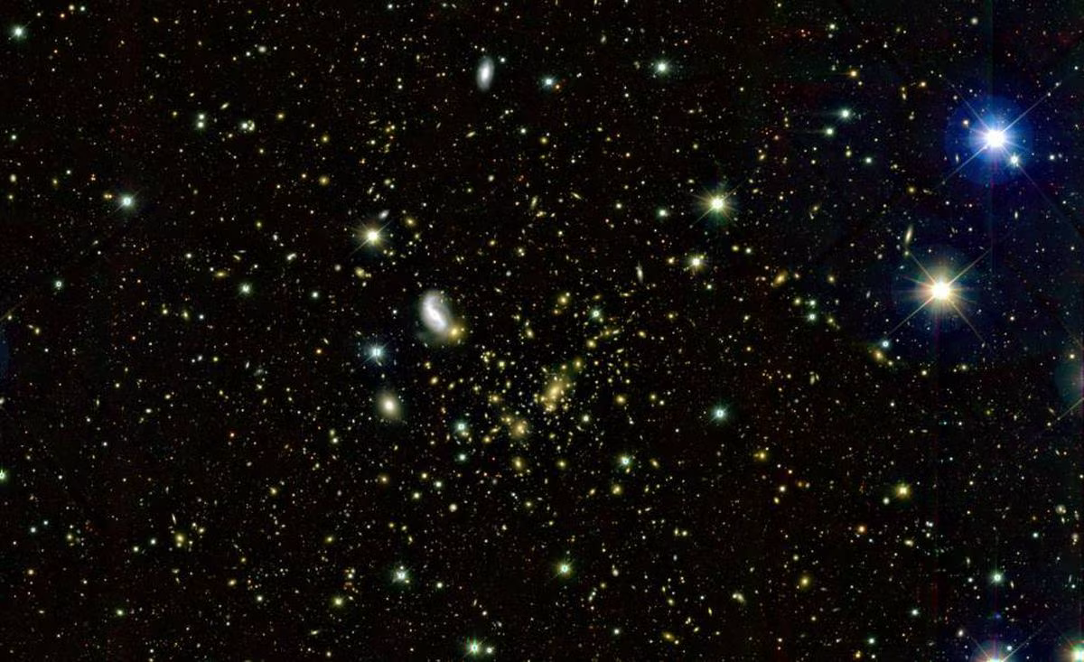
Study of high-energetic muon deflections
elpais.com/ciencia/2020-07-14/y-si-aristoteles-tenia-razon-sobre-la-composicion-del-universo.html
Pascal Gutjahr
TU Dortmund University
DPG 2023, Dresden

Slide 2
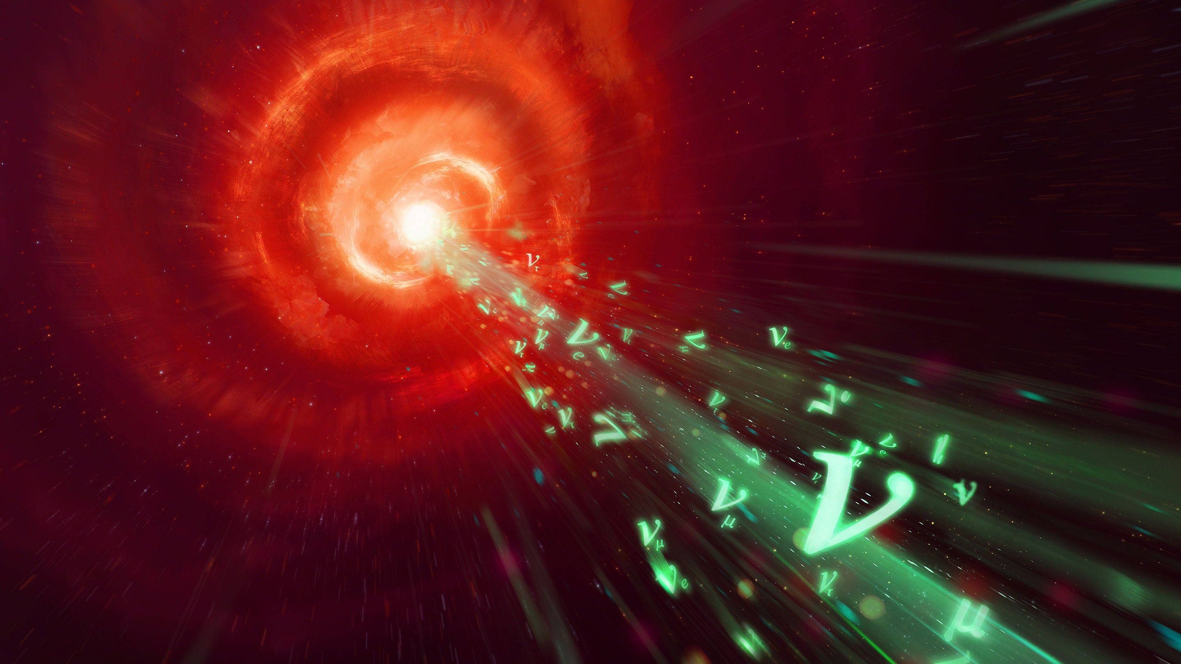
quantamagazine.org/neutrinos-linked-with-cosmic-source-for-the-first-time-20180712

Slide 3

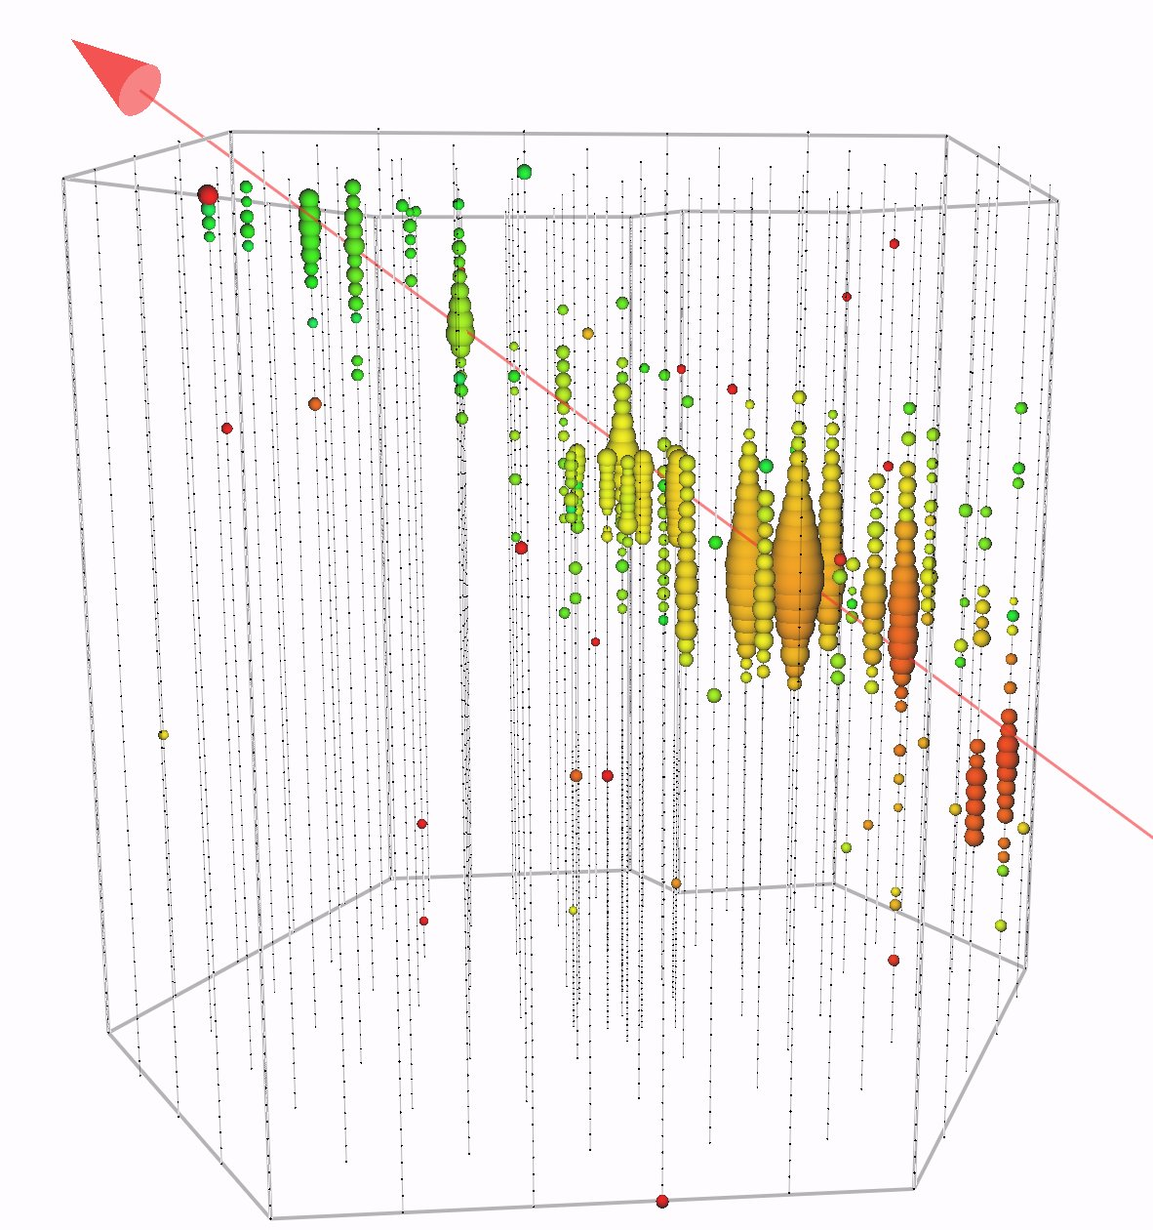
Motivation of muon deflection simulation
Muons travel up to several kilometers
PeV – TeV energies → forward boosted
Muons are assumed to traverse along a straight line
But:
Thousands of interactions
Large energy losses
Deflection in each interaction
Angular reconstructions are improved (< 1°)
What happens, when thousands of deflections accumulate?
Is a total deflection on the order of magnitude of current angular resolutions possible?
twitter.com/uw_icecube/status/1632750967035777026/photo/1

Slide 4
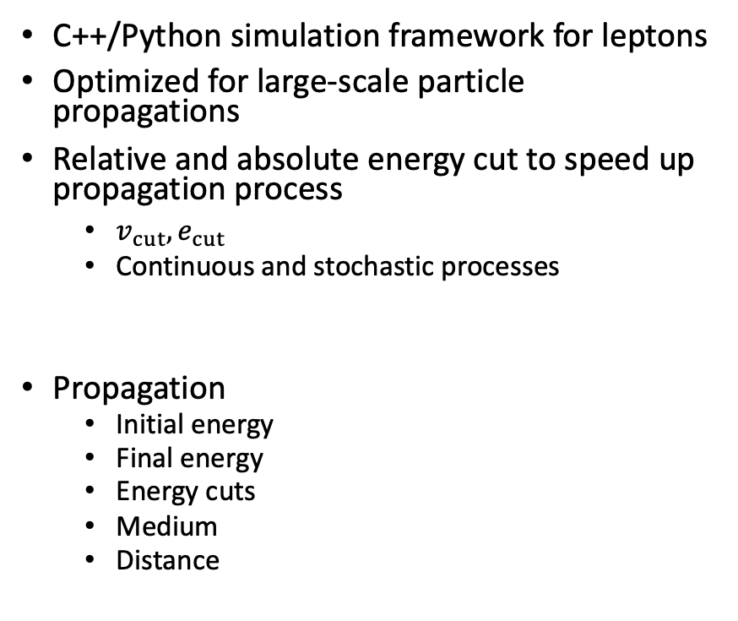
Simulation tool PROPOSAL
See T 92.5: Jean-Marco Alameddine
C++/Python simulation framework for leptons
Optimized for large-scale particle propagations
Relative and absolute energy cut to speed up propagation process
$v_{cut}, e_{cut}$
Continuous and stochastic processes
Propagation
Initial energy
Final energy
Energy cuts
Medium
Distance
Deflection
Multiple scattering
Molière
Highland
Stochastic deflection
Bremsstrahlung
Photonuclear interaction
Electron pair production
Ionization
Different parametrizations from Van Ginneken¹ and Geant4² are available
d
E_{i}
E_{f}
github.com/tudo-astroparticlephysics/PROPOSAL
¹ NIM A251 (1986) 21-39
² geant4.web.cern.ch

Slide 5
Muon deflection per interaction
1000 muons propagated in ice
Initial energy 1 PeV
Final energy 1 TeV
e_cut = 500 MeV, v_cut = 0.05
Largest median deflection by photonuclear interaction
Largest outliers by bremsstrahlung
Highland – Gaussian approximation neglects outliers
Deflection dominated by multiple scattering
P. Gutjahr et al. EPJ C 82, 1143 (2022)
MSM: multiple scattering Molière
MSH: multiple scattering Highland

Slide 6
Summary of single deflection
Single deflections extend over several order of magnitudes up to a few degrees
Muons do up to thousands of interactions
Question
Can all deflections along the muon propagation accumulate to a total deflection that impacts our angular resolution?
First, validate PROPOSAL results for accumulated deflection with other simulation tools and data

Slide 7
Comparison to other simulation tools
P. Gutjahr et al. EPJ C 82, 1143 (2022)
MUSIC¹
3D muon simulation code
Geant4²
Simulates passage of particles through matter very precisely, but intensive computing
Made for simulations in particle detectors
Good agreement in angular deflection
Small deviations in lateral displacement
Highland approximation neglects outliers
¹ Astropart. Phys. 7.4 (1997) 357-368
² geant4.web.cern.ch
1 Mio. muons are propagated from 2 TeV over a distance of 3 km in water

Slide 8
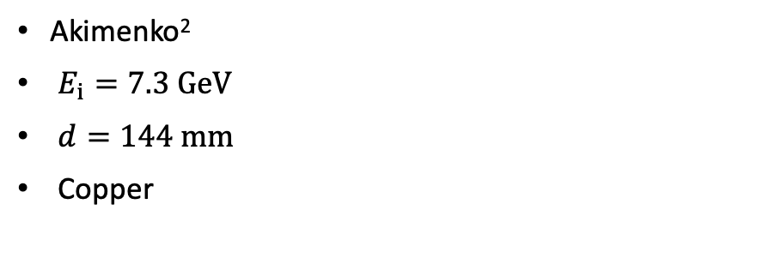
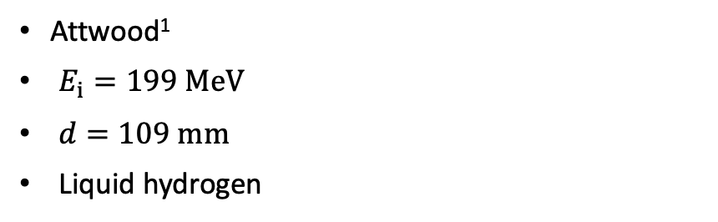
Data-MC checks
Attwood¹
$E_{i}=199 MeV$
$d=109 mm$
Liquid hydrogen
Akimenko²
$E_{i}=7.3 GeV$
$d=144 mm$
Copper
P. Gutjahr et al. EPJ C 82, 1143 (2022)
P. Gutjahr et al. EPJ C 82, 1143 (2022)
Good agreement in both measurements
PROPOSAL overestimates larger angles at GeV
¹ NIMB 251.1 (2006) 41-55
² NIMA 243 (1986) 518-522

Slide 9
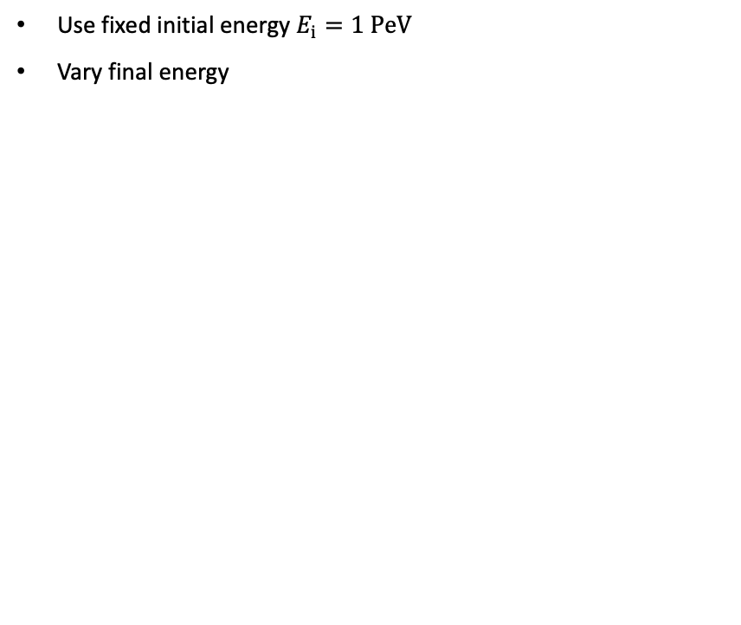
Accumulated deflection for several final muon energies
Use fixed initial energy $E_{i}=1 PeV$
Vary final energy
Deflection increases as final energy decreases
Check median deflection for different initial energies

Slide 10
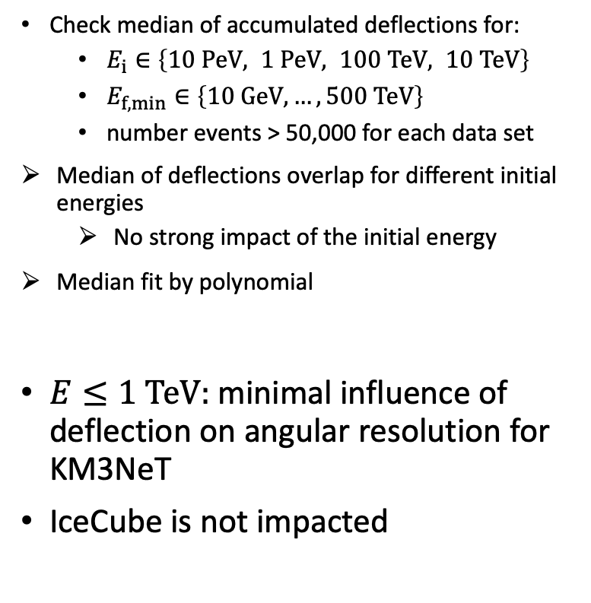
Impact of muon deflection on angular resolutions
Check median of accumulated deflections for:
$E_{i}∈\left\{10 PeV, 1 PeV, 100 TeV, 10 TeV\right\}$
$E_{f,min}∈\left\{10 GeV, …,500 TeV\right\}$
number events > 50,000 for each data set
Median of deflections overlap for different initial energies
No strong impact of the initial energy
Median fit by polynomial
$E≤1 TeV:$ minimal influence of deflection on angular resolution for KM3NeT
IceCube is not impacted
P. Gutjahr et al. EPJ C 82, 1143 (2022)

Slide 11
Impact of muon deflection on angular resolutions
Check median of accumulated deflections for:
$E_{i}∈\left\{10 PeV, 1 PeV, 100 TeV, 10 TeV\right\}$
$E_{f,min}∈\left\{10 GeV, …,500 TeV\right\}$
number events > 50,000 for each data set
Median of deflections overlap for different initial energies
No strong impact of the initial energy
Median fit by polynomial
$E≤1 TeV:$ minimal influence of deflection on angular resolution for KM3NeT
IceCube is not impacted
4 colors
P. Gutjahr et al. EPJ C 82, 1143 (2022)

Slide 12
Impact of muon deflection on angular resolutions
Check median of accumulated deflections for:
$E_{i}∈\left\{10 PeV, 1 PeV, 100 TeV, 10 TeV\right\}$
$E_{f,min}∈\left\{10 GeV, …,500 TeV\right\}$
number events > 50,000 for each data set
Median of deflections overlap for different initial energies
No strong impact of the initial energy
Median fit by polynomial
$E≤1 TeV:$ minimal influence of deflection on angular resolution for KM3NeT
IceCube is not impacted
4 colors
4 medians overlap
P. Gutjahr et al. EPJ C 82, 1143 (2022)

Slide 13
Estimate muon deflection uncertainty on angular reconstruction
No information about the muon before the detector entry
We can only reconstruct the muon at the detector entry
Energy
Direction
Detector entry energy = final muon energy
Muon deflection depends only on the final muon energy
Use reconstructed muon energy to estimate the muon deflection before the detector entry
Systematic uncertainty

Slide 14
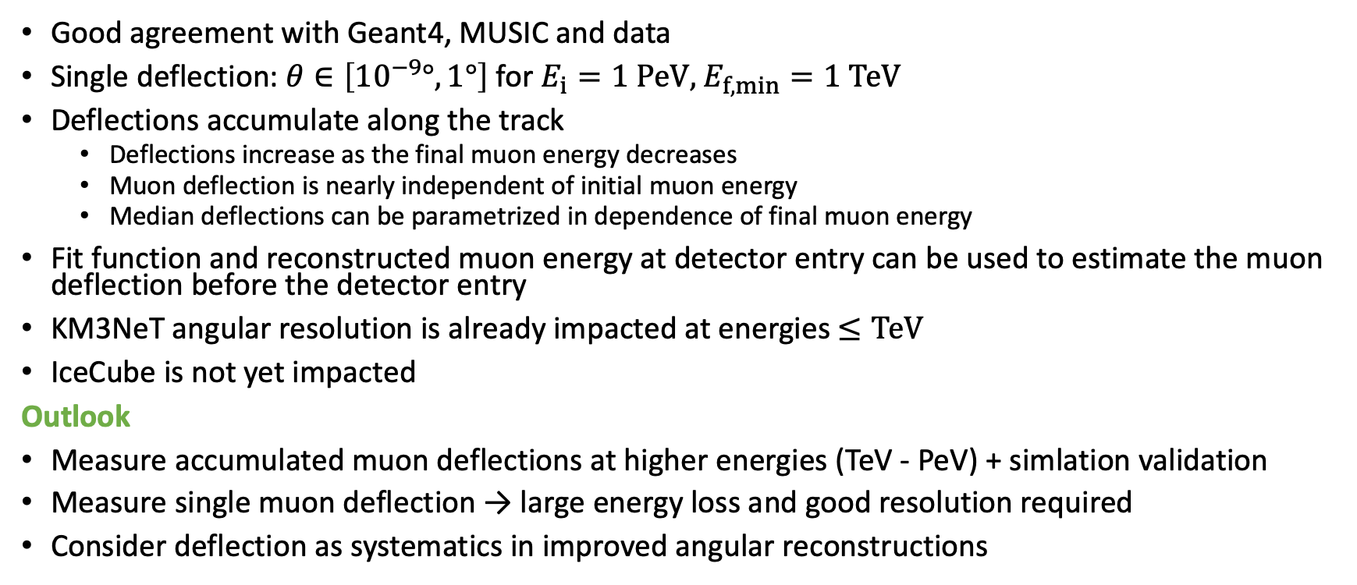
Summary & Outlook
Good agreement with Geant4, MUSIC and data
Single deflection: $θ∈\left[{10}^{−9}°, 1°\right]$ for $E_{i}=1 PeV$, $E_{f,min}=1 TeV$
Deflections accumulate along the track
Deflections increase as the final muon energy decreases
Muon deflection is nearly independent of initial muon energy
Median deflections can be parametrized in dependence of final muon energy
Fit function and reconstructed muon energy at detector entry can be used to estimate the muon deflection before the detector entry
KM3NeT angular resolution is already impacted at energies $≤TeV$
IceCube is not yet impacted
Outlook
Measure accumulated muon deflections at higher energies (TeV - PeV) + simlation validation
Measure single muon deflection → large energy loss and good resolution required
Consider deflection as systematics in improved angular reconstructions

Slide 15
Backup

Slide 16
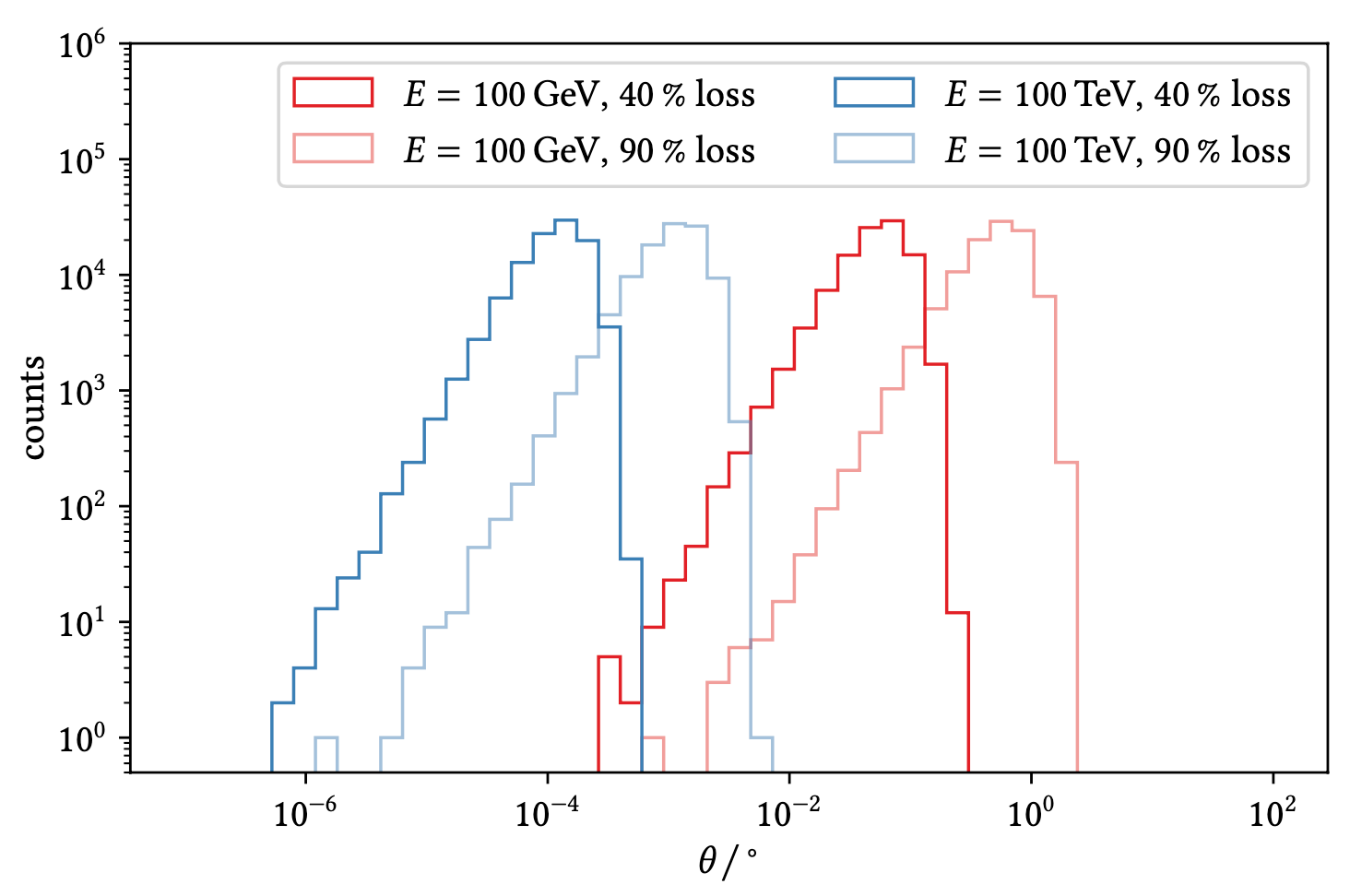
Electron pair production – Van Ginneken
Several orders of magnitude for fixed energy and energy loss

Slide 17
Energy rescale to muon energy
Bjorken variables are used to transfer neutrino energies to muon energies

Slide 18
Median deflections with different energies cuts
1 PeV to 1 TeV, 1000 events each, Molière, 95% Interval
Low cuts –> more stochastic propagation
Leads to lower deflections
Molière simulates larger deflections at higher energies
See Akimenko

Slide 19
Deflection in dependence of propagation distance
3 data points per line
median ●, lower ▲ and upper ▼ bound 90% CL
using data within ± 10%
propagation distance depends on initial particle energy
deflection increases with propagation distance
deflection is similar for medians of propagation distance for different initial energies

Slide 20
Deflection in dependence of propagation distance
Initial muon energies are sampled from a Gaisser muon flux model
No color change along a fixed muon energy column
No large impact of propagation distance on the muon deflection
P. Gutjahr et al. EPJ C 82, 1143 (2022)

